Slide 1

Communication Kit (Kit 3)
Communication Foundation Lessons (CFL)
(Lesson Ref: CFL04)
CFL04: Sensor (DHT11) Data Logging Using SD Card Module

Slide 2
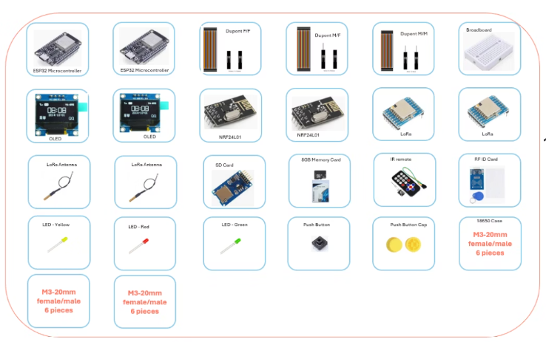
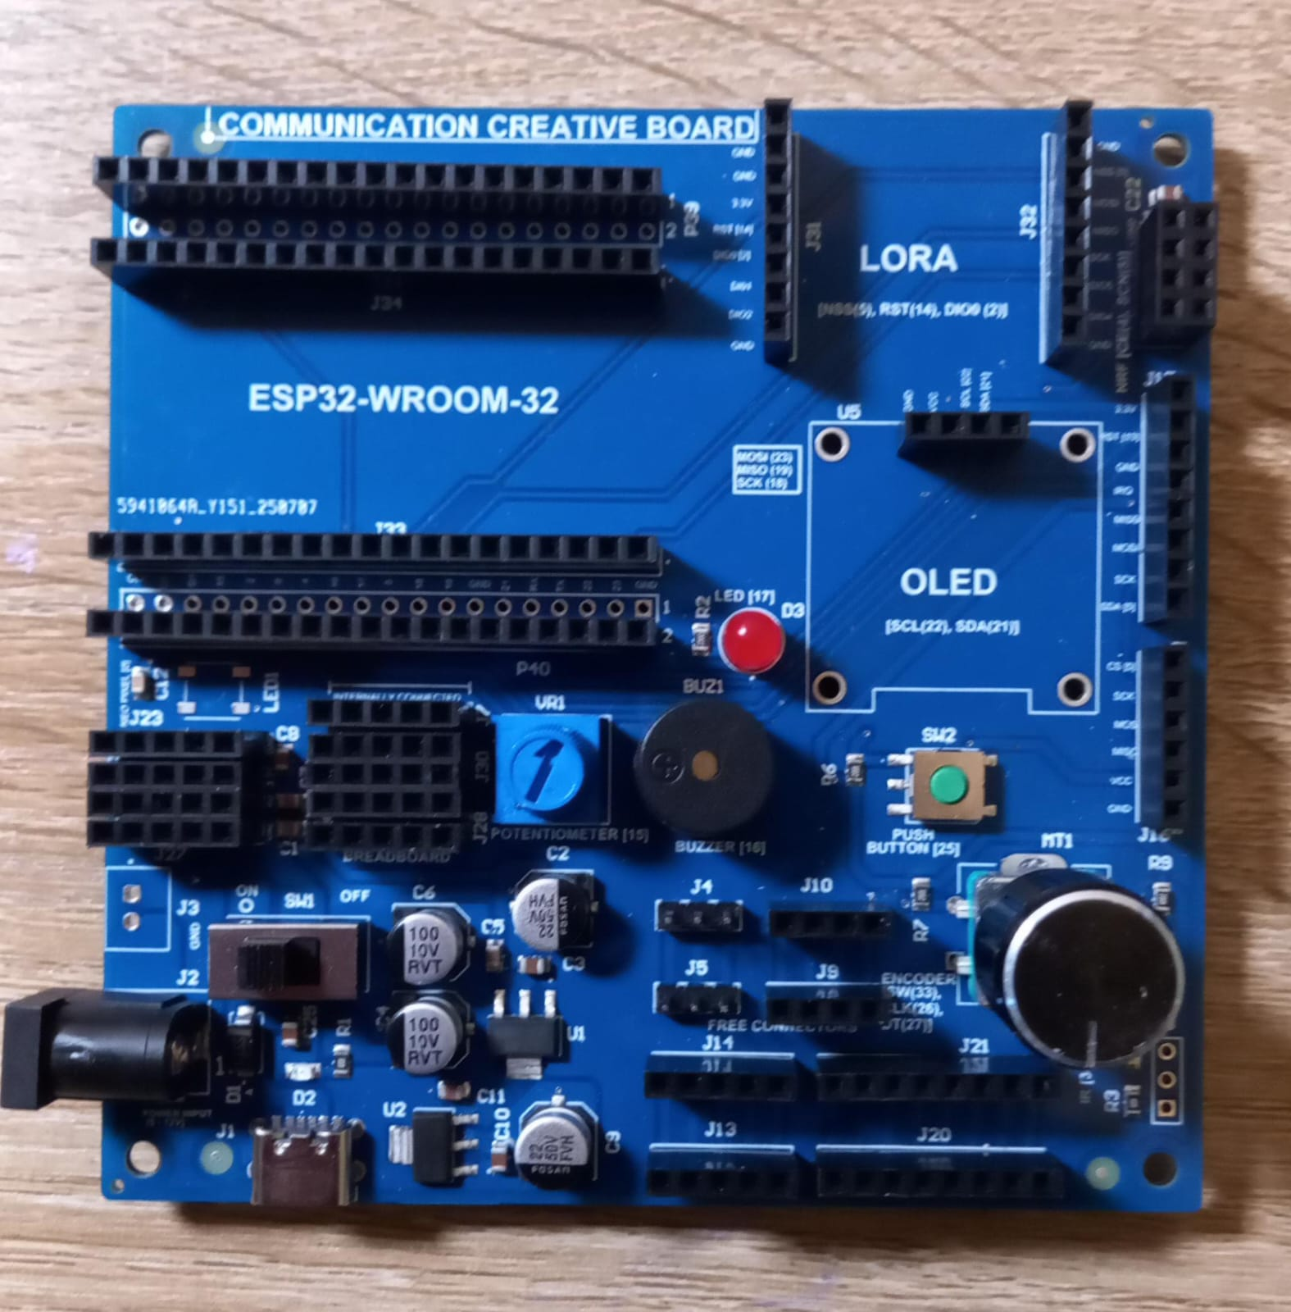
Communication Kit : Contents
Communication Kit Components
Communication Creative Board

Slide 3
Kit 3 Communication Creative Board - Features
LoRa Module I/F
NRF24L01 Module I/F
ESP32
OLED I/F
RFID I/F
Mini
Breadboard
SD Card Module I/F
Power
Connector
Rotary Encoder
ON/OFF Switch
Input DC Jack
Free Connectors

Slide 4
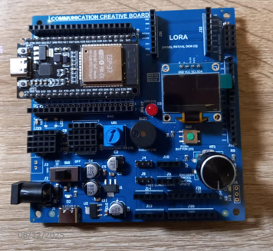
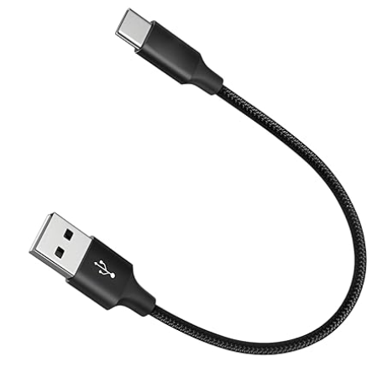
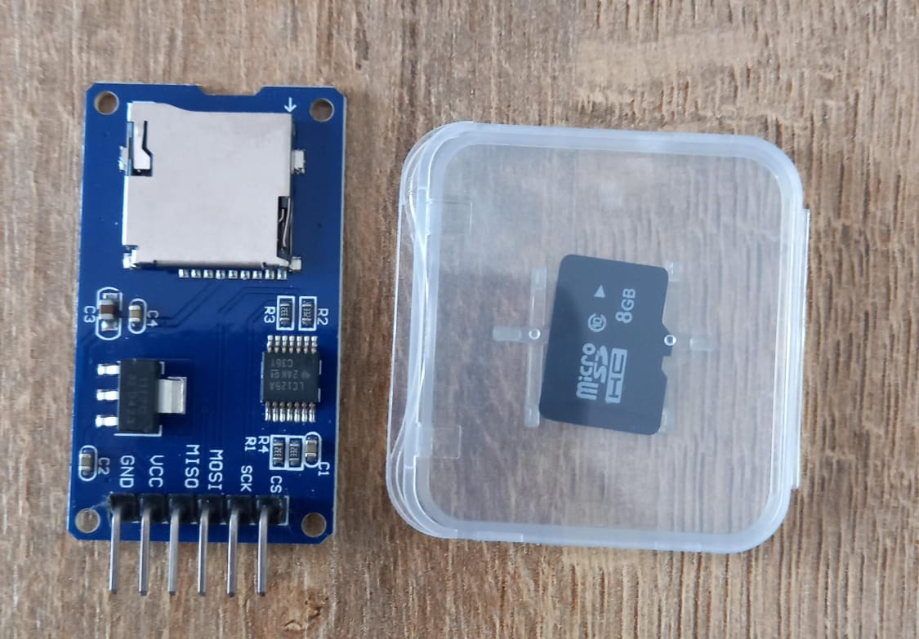
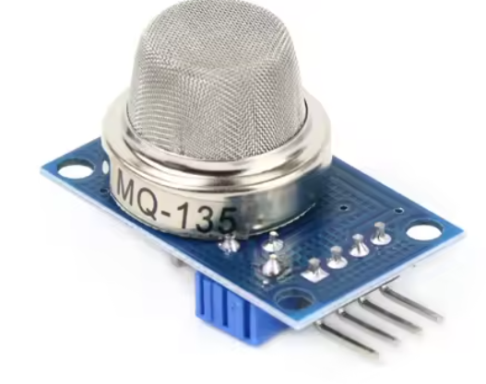
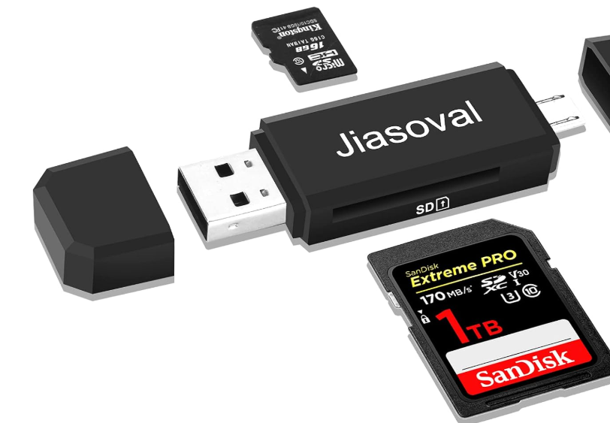
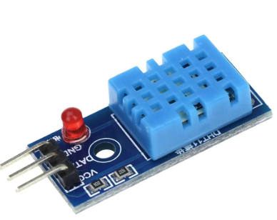
CFL04 : Sensor (DHT11) Data Logging Using SD Card Module
Things Needed

Slide 5
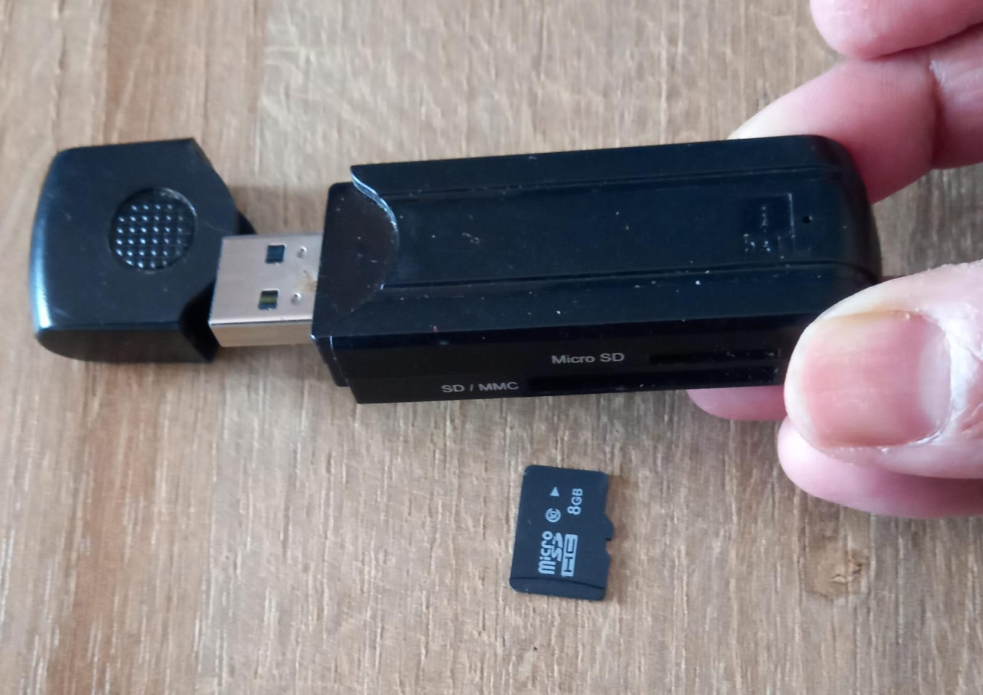
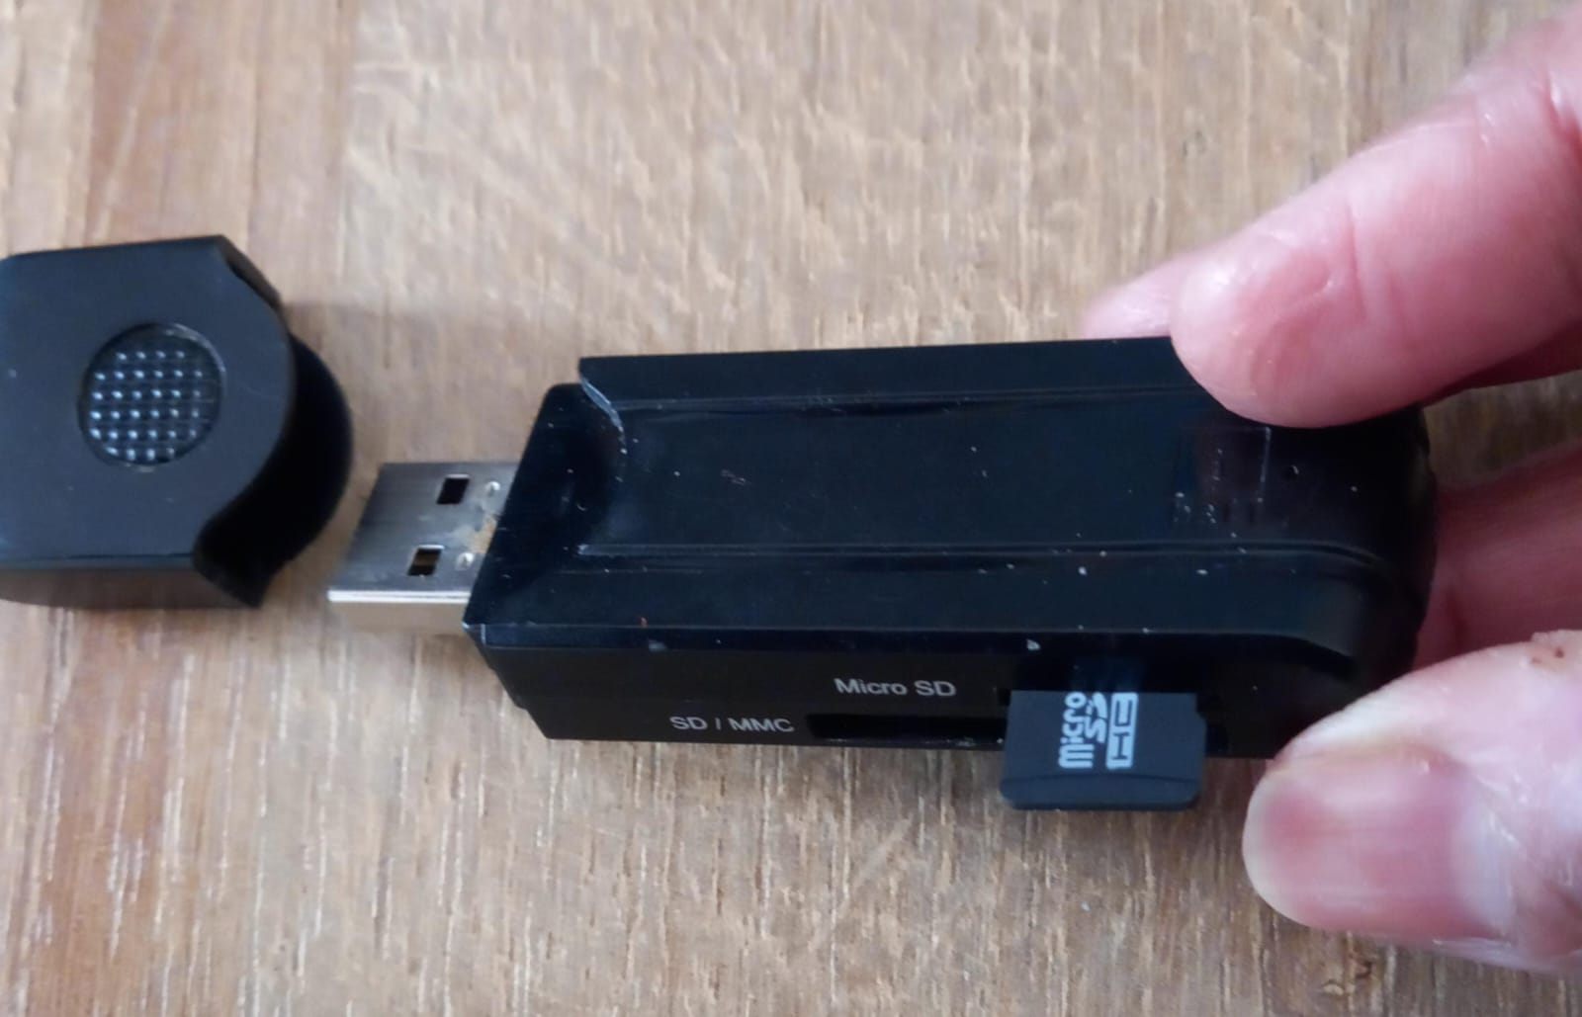
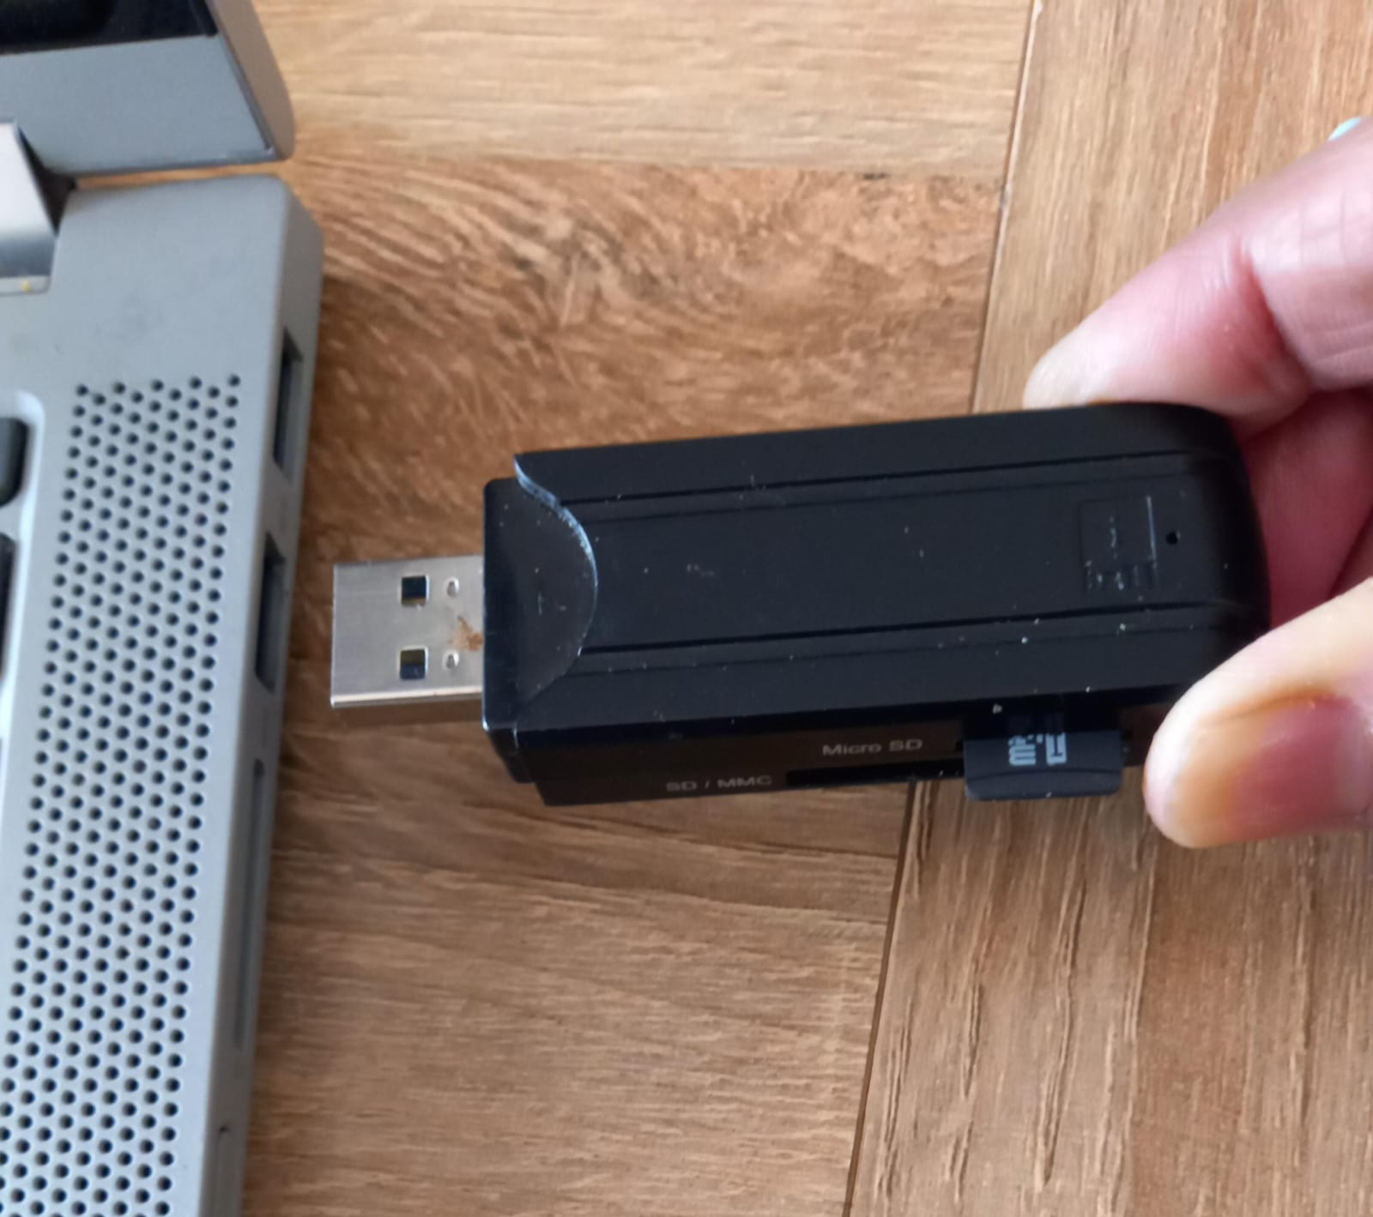
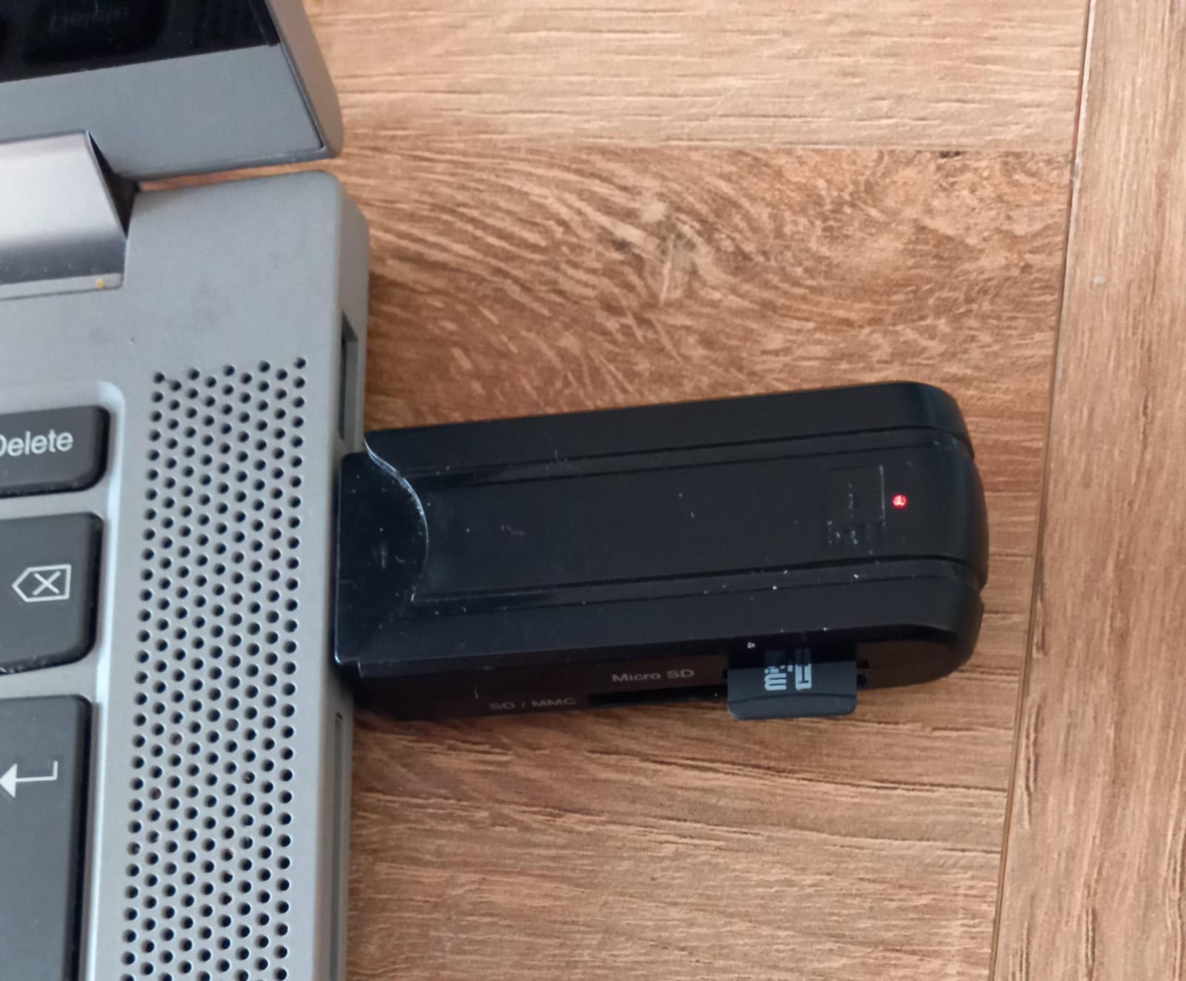
CFL04: Format SD Card
1
2
3
4
5

Slide 6
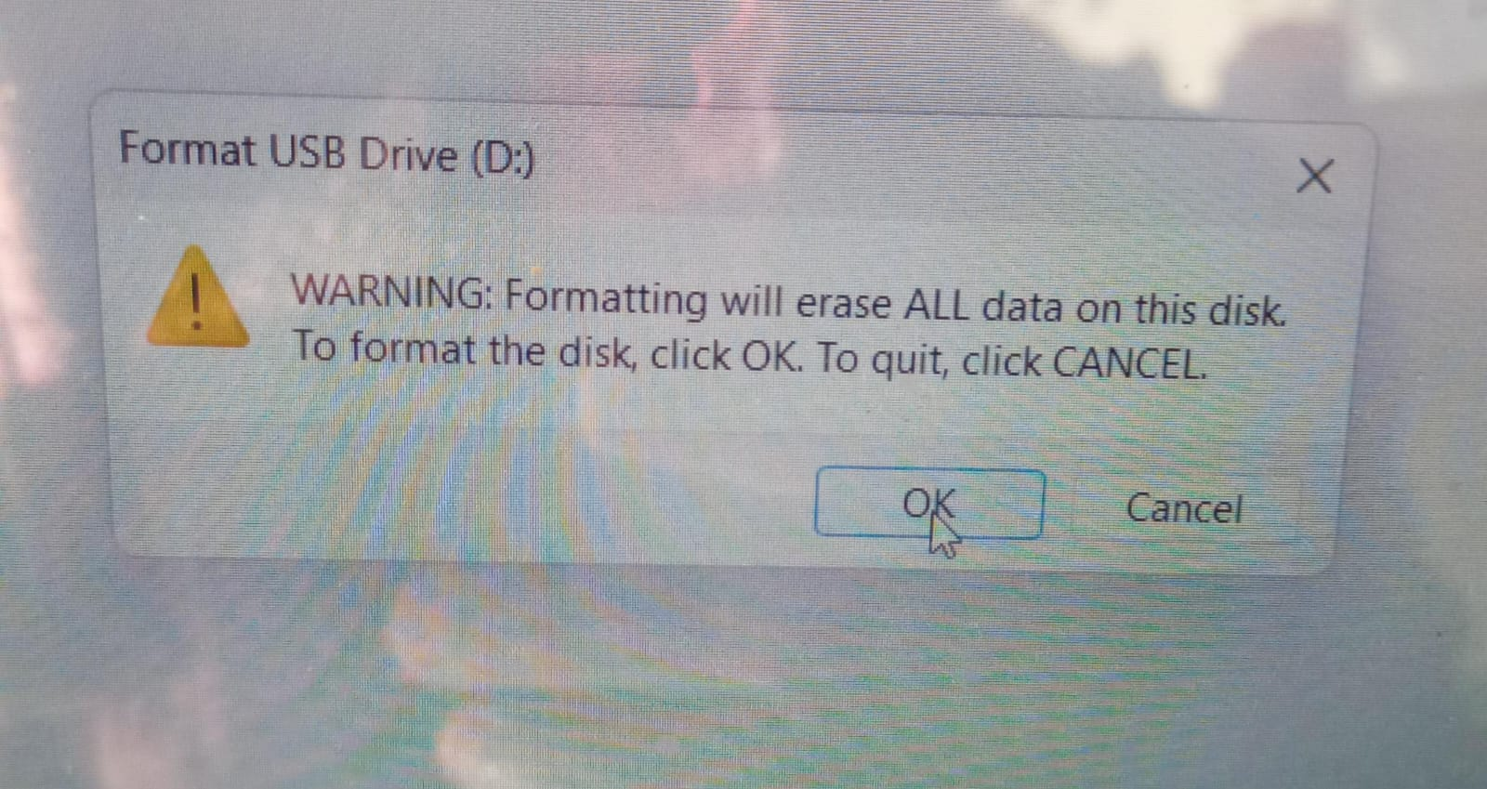
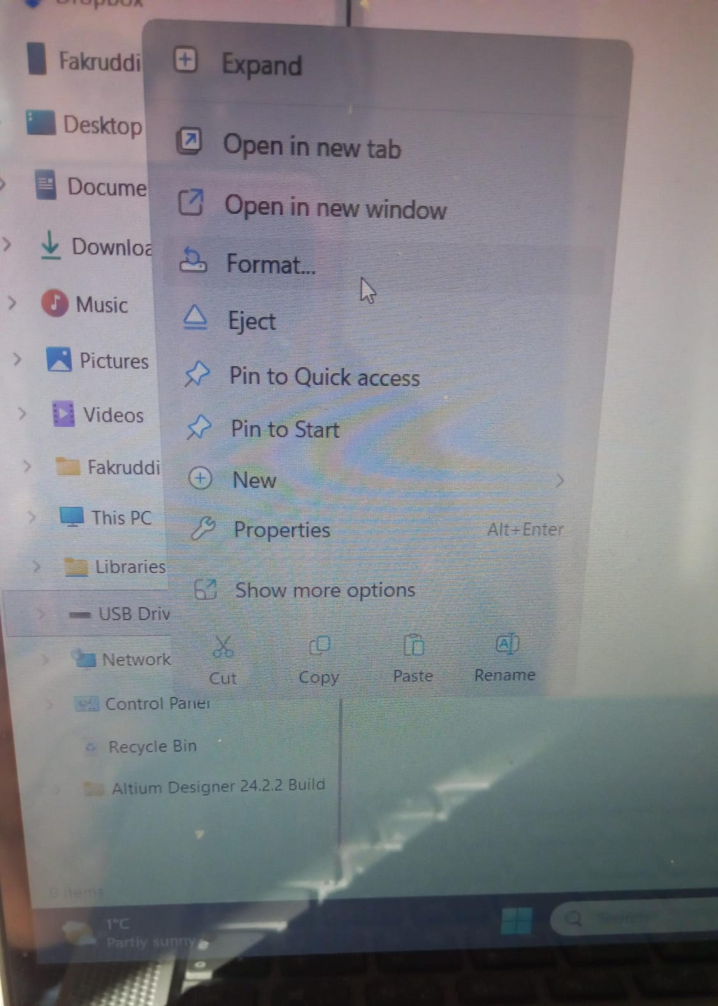
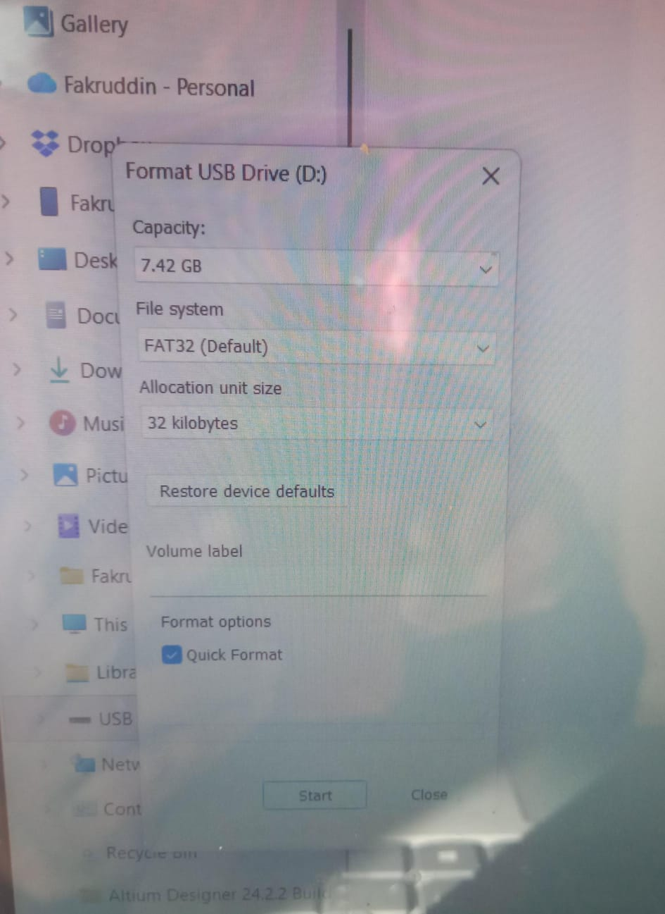
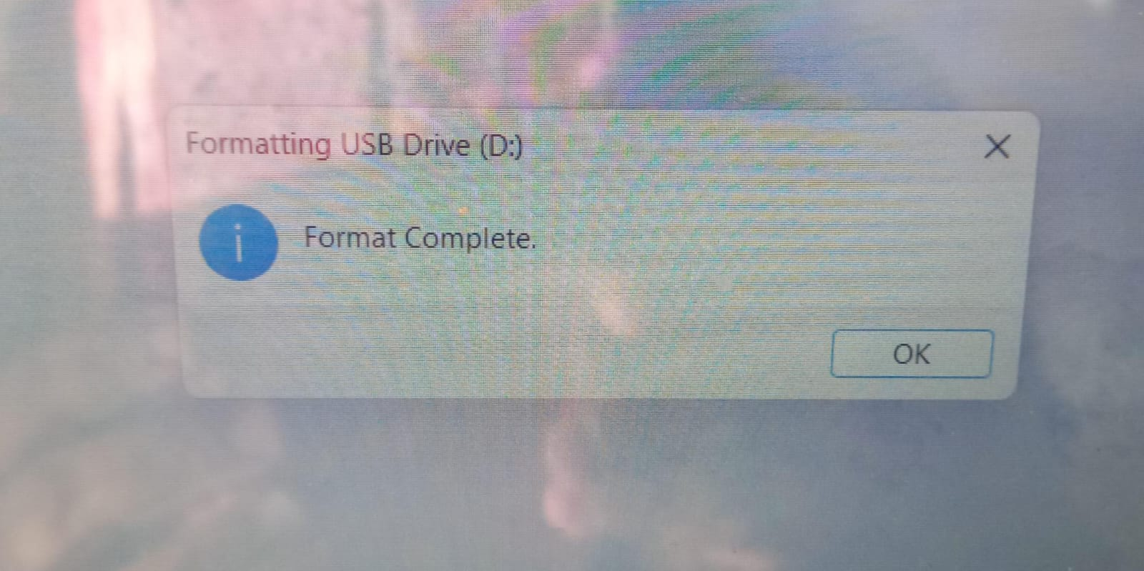
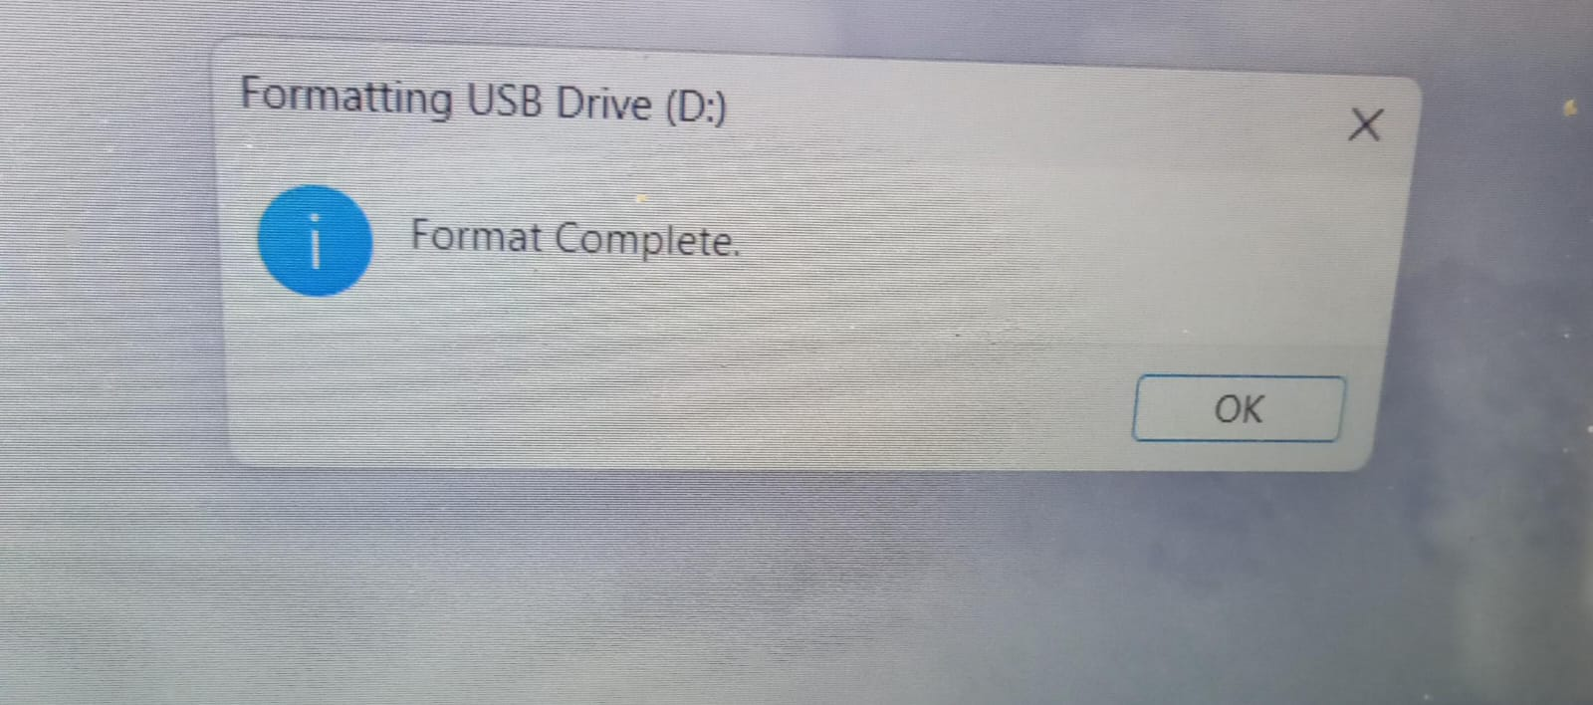
CFL04: Format SD Card
7
6
8
9
10

Slide 7
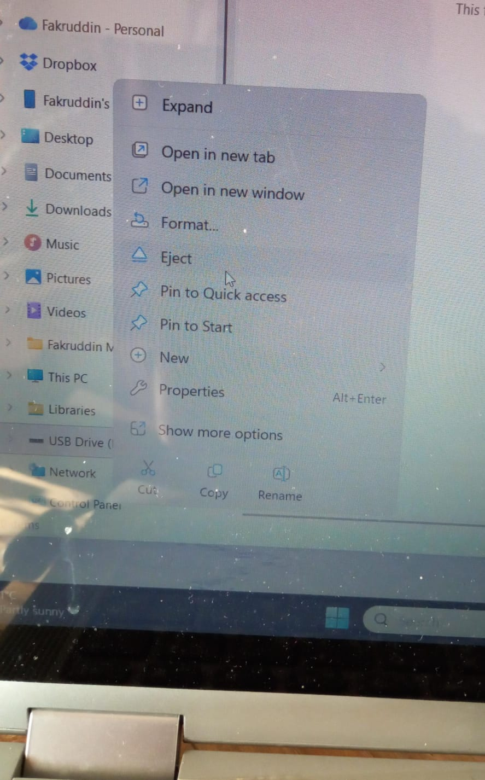
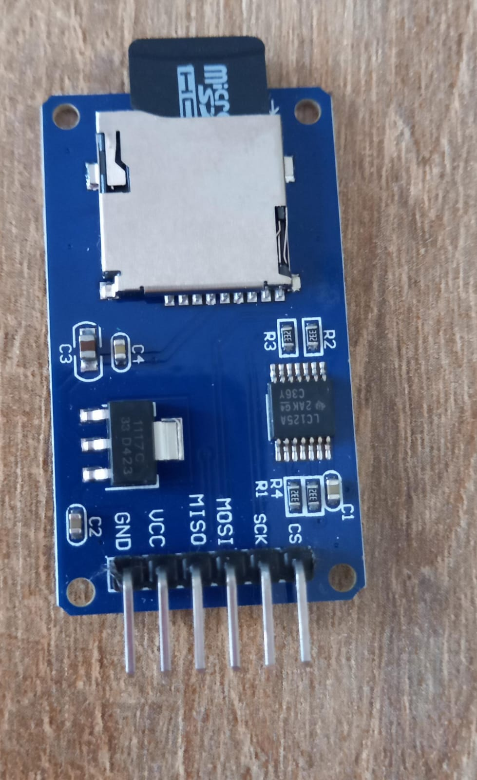
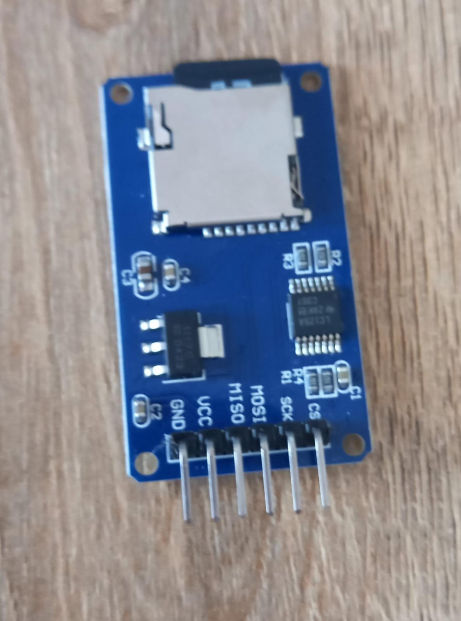
CFL04: Format SD Card
11
12
10 !!!!!

Slide 8
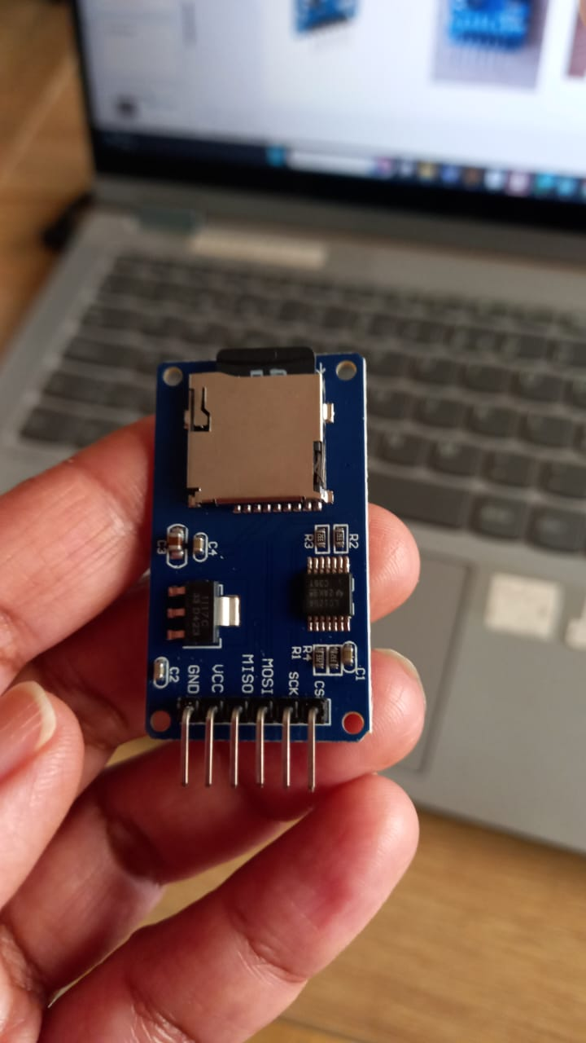
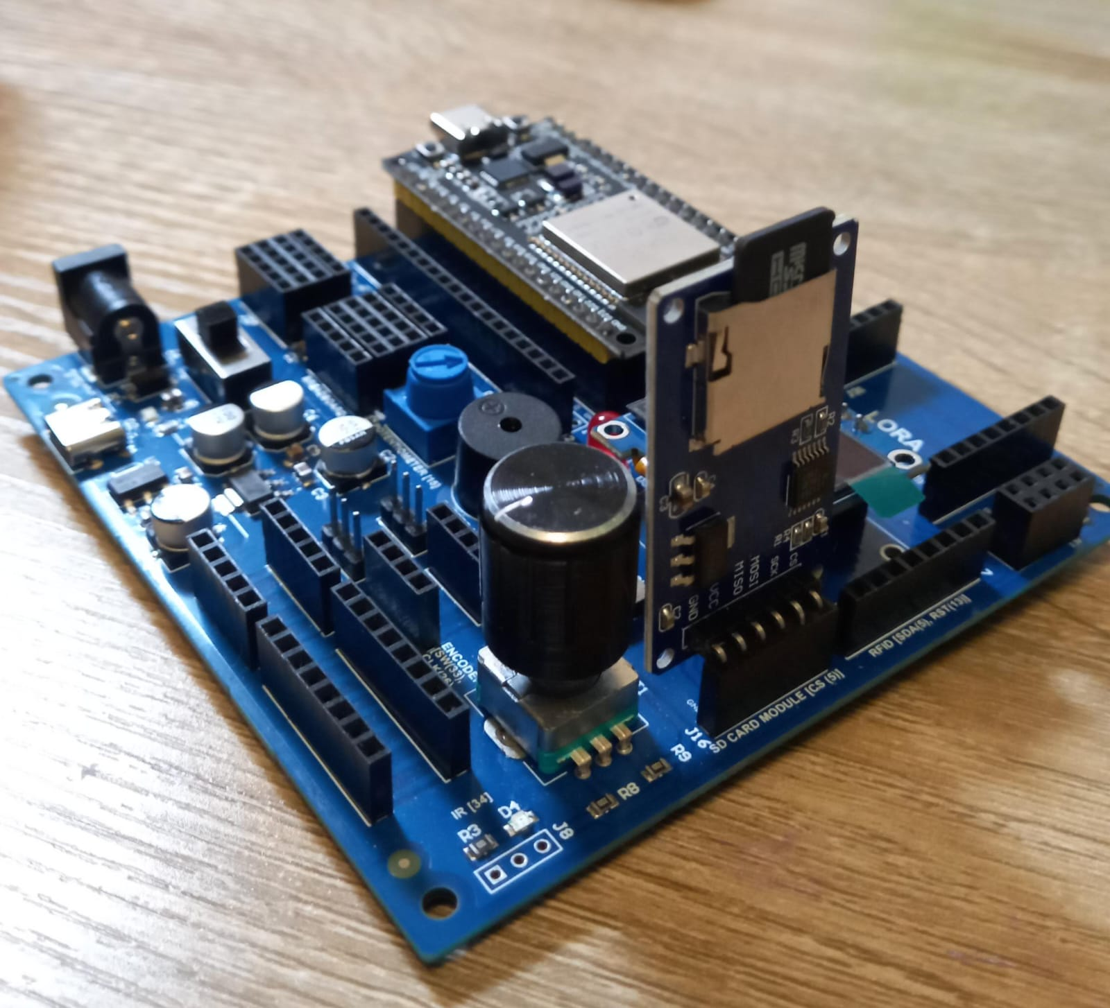
CFL04 : Sensor (DHT11) Data Logging Using SD Card Module

Slide 9
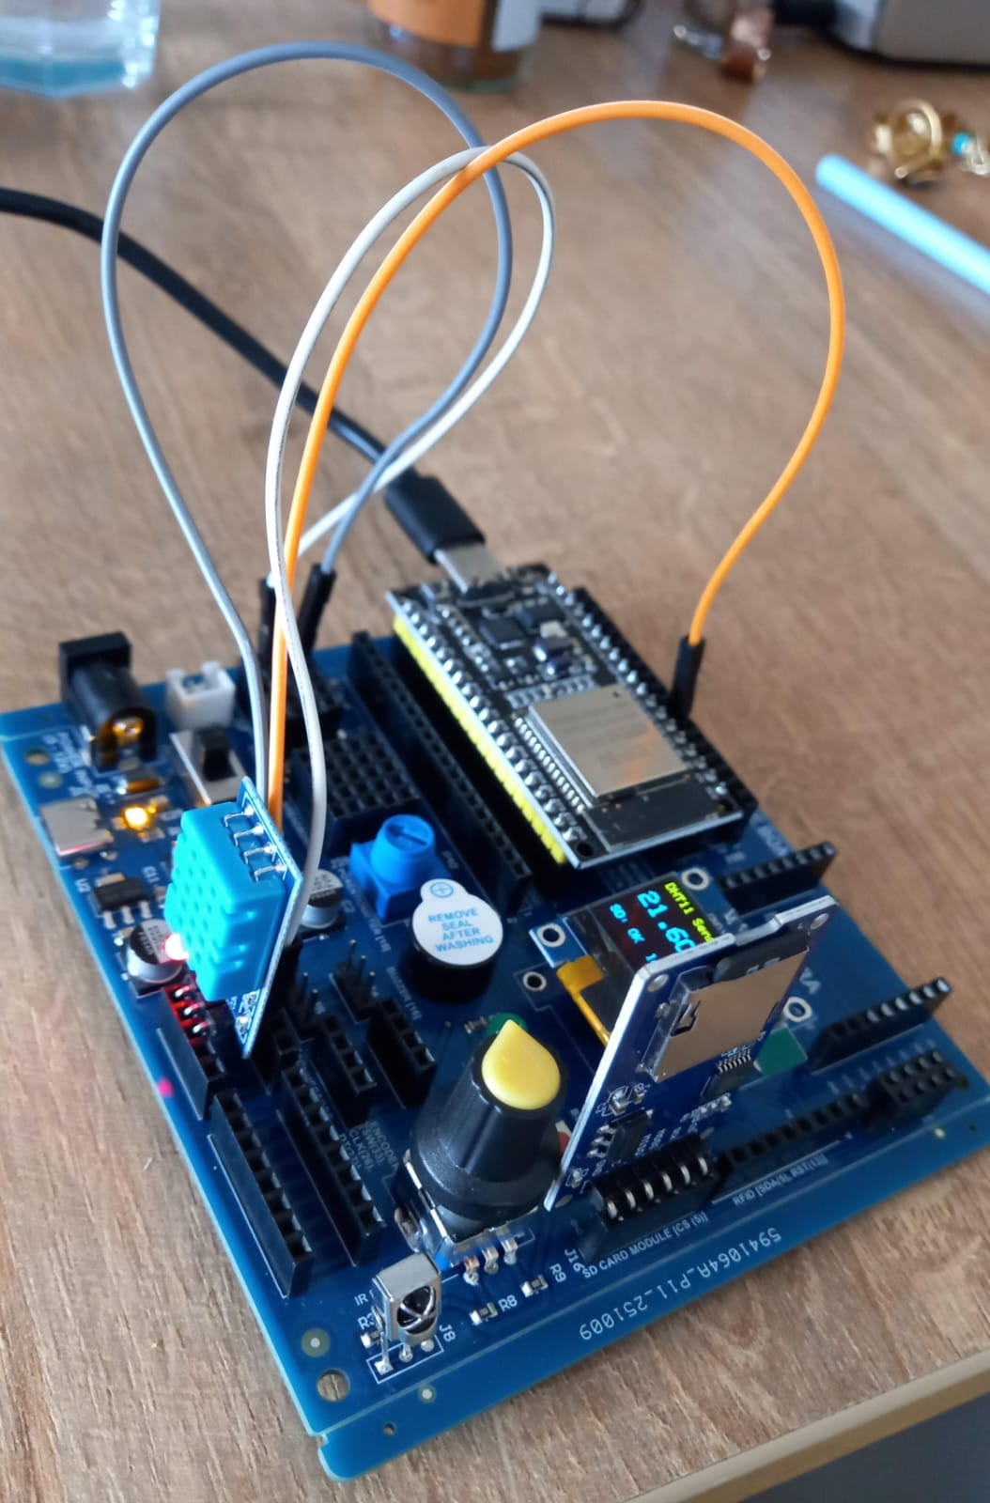
CFL04 : Sensor (DHT11) Data Logging Using SD Card Module
DHT11 | ESP32 Pin
VCC | 5V
GND | GND
Data | 33

Slide 10
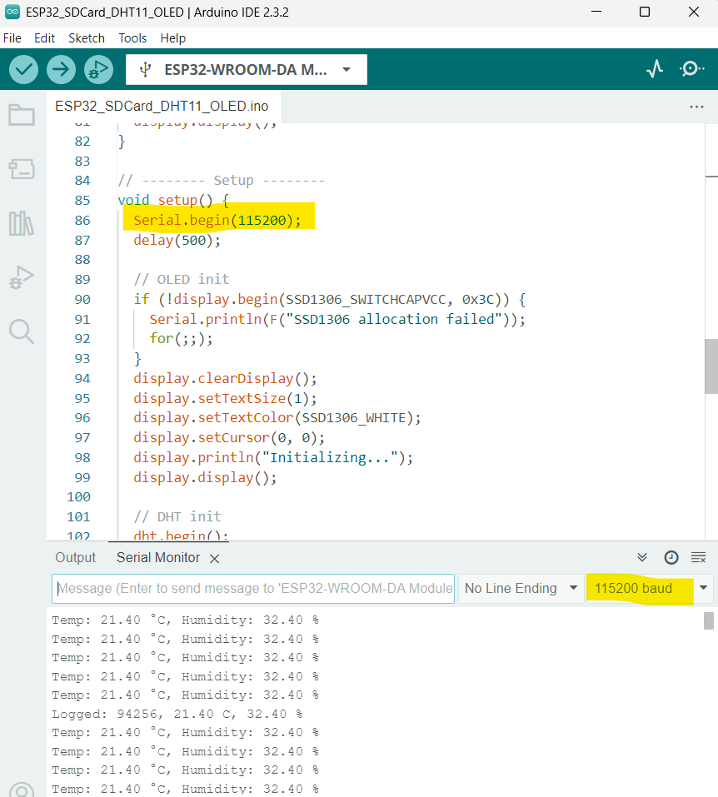
CFL04 : Sensor (DHT11) Data Logging Using SD Card Module
Code for Lesson CFL04 (CFL04_SDCard_DHT11_OLED.ino):
https://github.com/info-zas/zas-robotics-communications/blob/main/01_FoundationProjects/CFL04_SDCard_Sensor_Data_Logging/CFL04_SDCard_DHT11_OLED/CFL04_SDCard_DHT11_OLED.ino

Slide 11
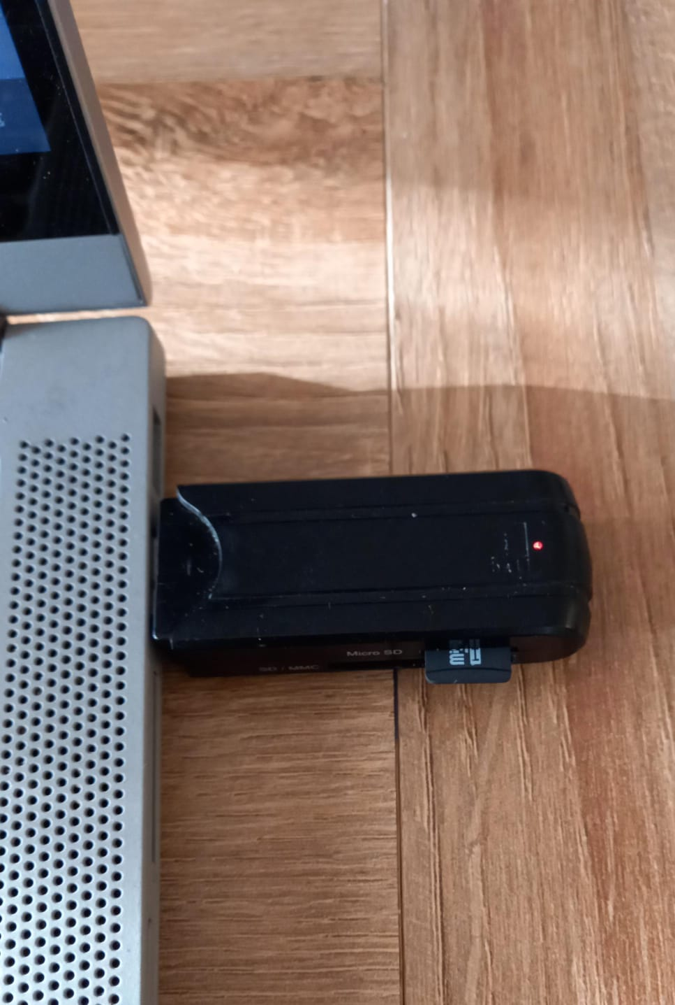
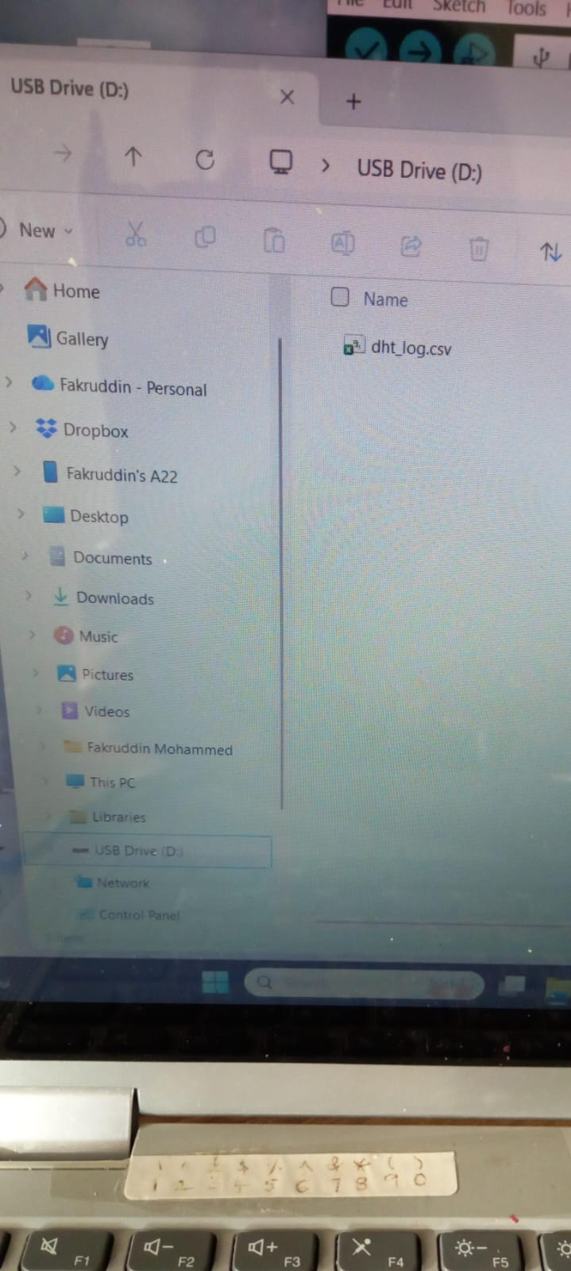
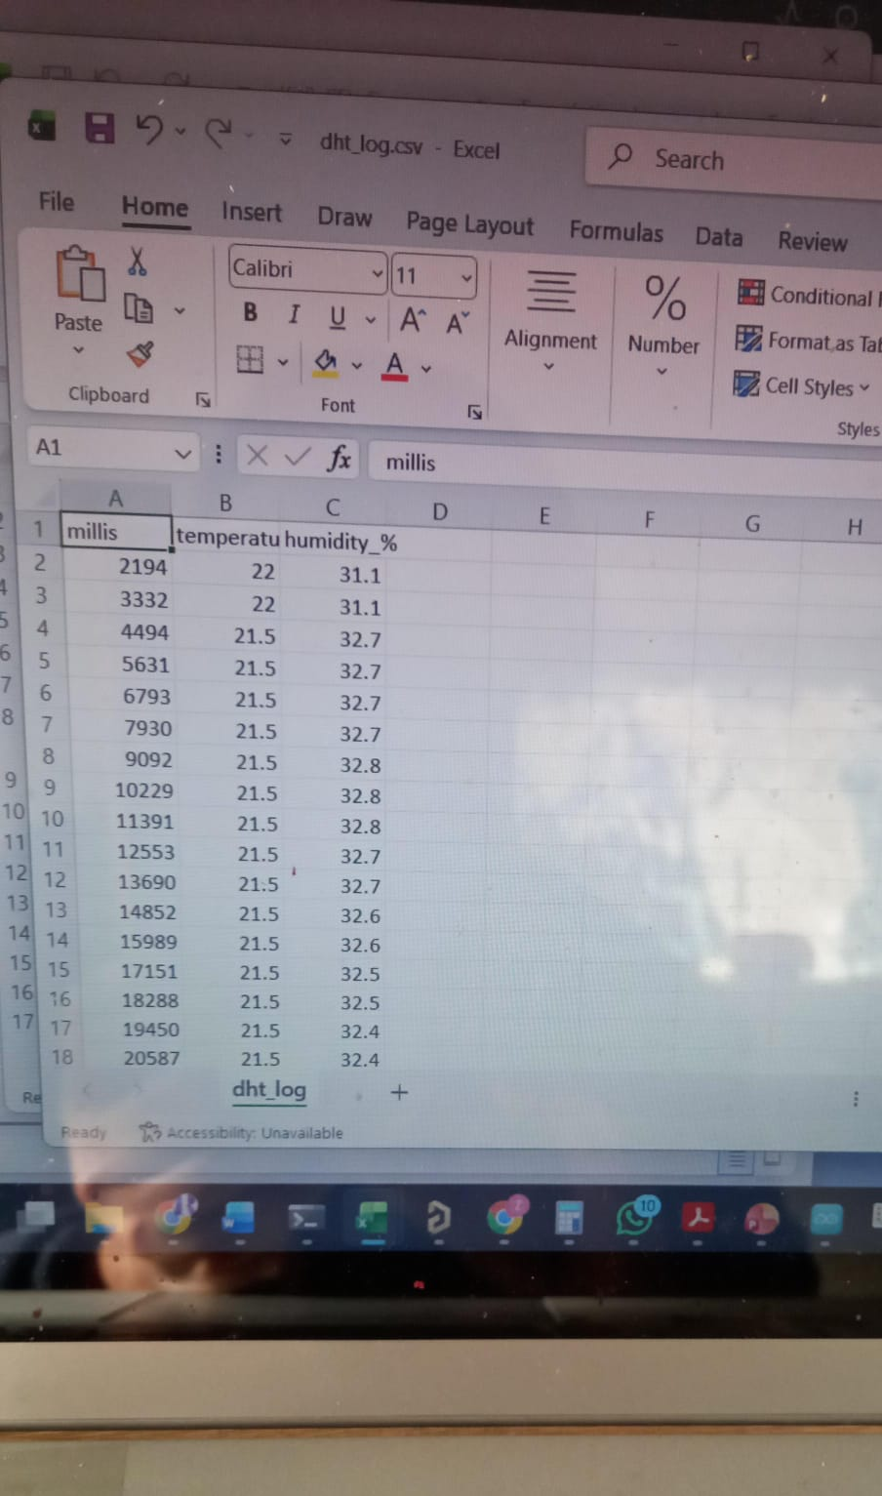
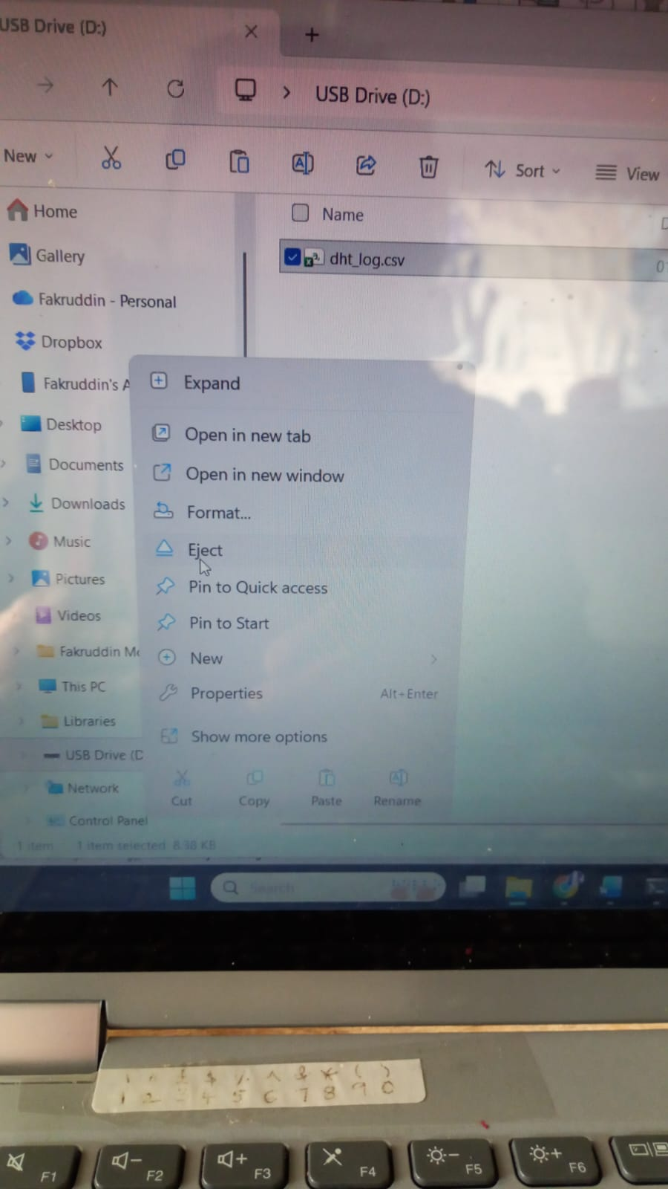
CFL04 : Sensor Data Reading – From the SD Card -> to the Laptop

Slide 12
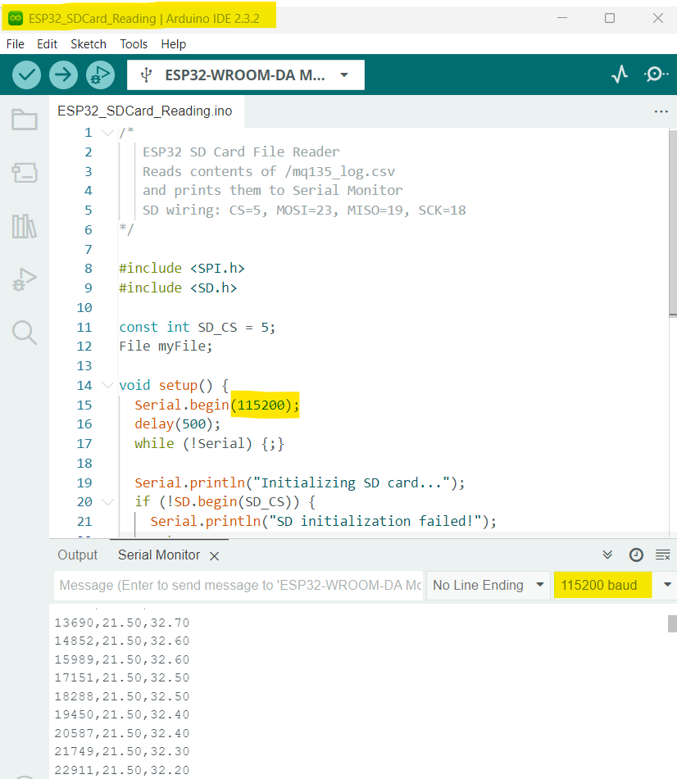
CFL04 : Sensor Data Reading – From the SD Card -> to Serial Monitor
Code for Lesson CFL04 (CFL04_SDCard_Reading.ino):
https://github.com/info-zas/zas-robotics-communications/blob/main/01_FoundationProjects/CFL04_SDCard_Sensor_Data_Logging/CFL04_SDCard_Reading/CFL04_SDCard_Reading.ino
Press ‘En’ on ESP32

Slide 13
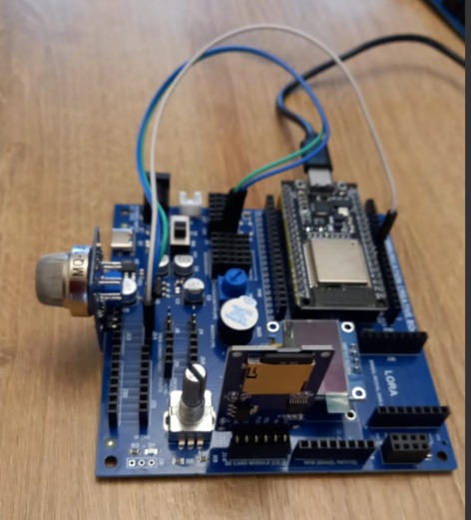
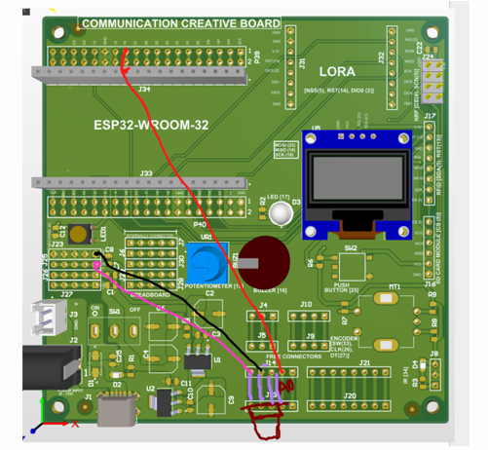
CFL04 : MQ-135 Data Logging in SD Card
MQ-135 | ESP32 Pin
VCC | 3.3V
GND | GND
A0 | 32
Code for Lesson CFL04 (CFL04_SDCard_Pollution_OLED.ino):
https://github.com/info-zas/zas-robotics-communications/blob/main/01_FoundationProjects/CFL04_SDCard_Sensor_Data_Logging/CFL04_SDCard_Pollution_OLED/CFL04_SDCard_Pollution_OLED.ino

Slide 14
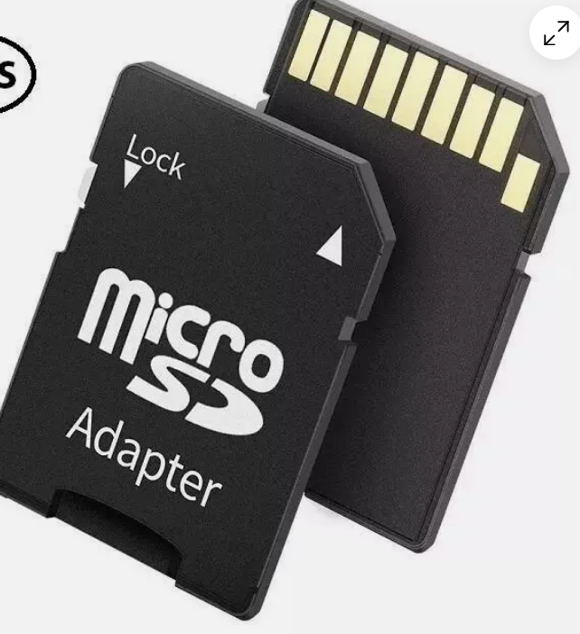
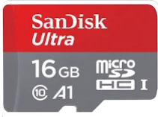
CFL04 : Extra Slide – SD Card Adaptors
+
OR

